Slide 1
Blood analyzers data anomaly detection
James Nguyen
Yang Yang Qian
Weixing Sun Annalaissa Johnson

Slide 2
Problem statement
A recent change to internal Interpretive Protocol (IP) algorithm cause many client’ customers to complain about excessive IP based flagging. Some customers did not complain, yet many did. Also, at some customer sites with multiple analyzers, some of the analyzers seemed to flag appropriately while some did not. Current anomaly detection mechanism cannot capture these problems
The client does not know which analyzers are performing correctly and which are not. Of course, the flagging is depended on the local population and medical conditions associated with that population.
Current mechanism does not take into account relevant data points and cannot process big volume of real time data

Slide 3
Current anomaly detection mechanism
Manual trend observation
Simple thresholds based
Decrease over time
MONO% 4-14%
MONO# 4-16%
IRF 12-23%
HPC 2-6%
IG# 3-7%
IG% 2-4%
Increase over time
MCV 1-2%
RDW-SD 1-2%
PLT-O 2-16%
RET# 6-15%
RET% 6-15%

Slide 4
Factors impacting to sensitivity
The IP flagging level set by the customer. Most customers set to recommended levels based on the type of the customer {Reference Lab, Hospital, Cancer Clinic, Children's}. It is not known what the levels are set to in the analyzer.
Where the analyzer parameters are calibrated by the field service engineer. Calibration results can be determined by comparing an analyzers QC results to the QC of the analyzer's peers (or group). Relative calibration values can be determined.
Characteristics of the local population's blood which often changes season to season.
How well the analyzer is mechanically running. I.e. slight clogs in tubing, quality of the optical alignments, or drifts in pressures and temperatures may cause minor variation. However, it is believed analyzer's quality of results are factored into the QC data recovery values. Recall the QC material is 'simulated blood' and may not necessarily factor all conditions related to the measurements of whole blood (whole blood is patient blood).
The software version number as some changes to the IP (Interpretive Protocol) algorithm which causes the IP levels to be different between software versions. While these changes do not occur often, when they do, it is often to correct a problem yet we discover unintended consequences to these changes in the flagging levels.

Slide 5
Data
Flagging data
Field | Description
ProductID | Unique ID of Analyzer
Date-Time | Date Time of the reading. Typically once per day.
IPUVersion | Software version of the ProductID.
CBCCounter | Absolute counter of the CBC or Complete Blood Counters since last report. This could include Whole Blood or QC samples.
DIFFCounter | Absolute counter of the Diff channel since last report. Could include counts for both QC and WholeBlood.
WBModeCounter | This counts the number of time whole blood is analyzed. A QC sample would not increment this counter.
WBCAbnSctCounter
IGPresentIPCounter
BlastIPCounter
LeftShiftIPCounter
AtypicalLymphIPCounter
AbnLymphIPCounter
DimorphicPopulationIPCounter
RETAbnSctIPCounter
RBCAgglutionationIPCounter
BlastAbnLymphoIPCounter
PRBSIPCounter
PLTAbnSctIPCounter
PLTClumpIPCounter
FragmentIPCounter
X Bar Data
ProductID * | CRM Unique System Product ID CRM.
IPUVersion | The software version of the ProductID. The software version controls an internal algorithm which impacts the values readings.
XBarMDateTime * | Date-Time of the XBarM Reading
WDF-X_XBarM | X Bar M Value for WDF-X
WDF-Y_XBarM | X Bar M Value
WDF-Z_XBarM | X Bar M Value
QC Data
ProductID | Unique Analyzer Identifier
IPUVersion | Software Version of the ProductID
QCLotNumber | QC Lot Number (8 digit)
QCLotStartDate | Start Date of QC Lot Number. The lot only lasts 100 days and parameters drift over time. Therefore, the analysis may need to know hold 'old' the lot is.
Date-Time | Date time of Value reading
WDF-X | QC Value
WDF-Y | QC Value
WDF-Z | QC Value

Slide 6
Our approach
Data transformation (big data)
Exploratory data analysis
Building prediction model
Building (real time & scale up) dashboard application

Slide 7
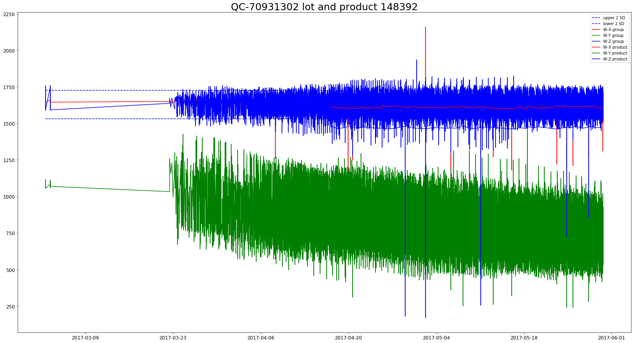
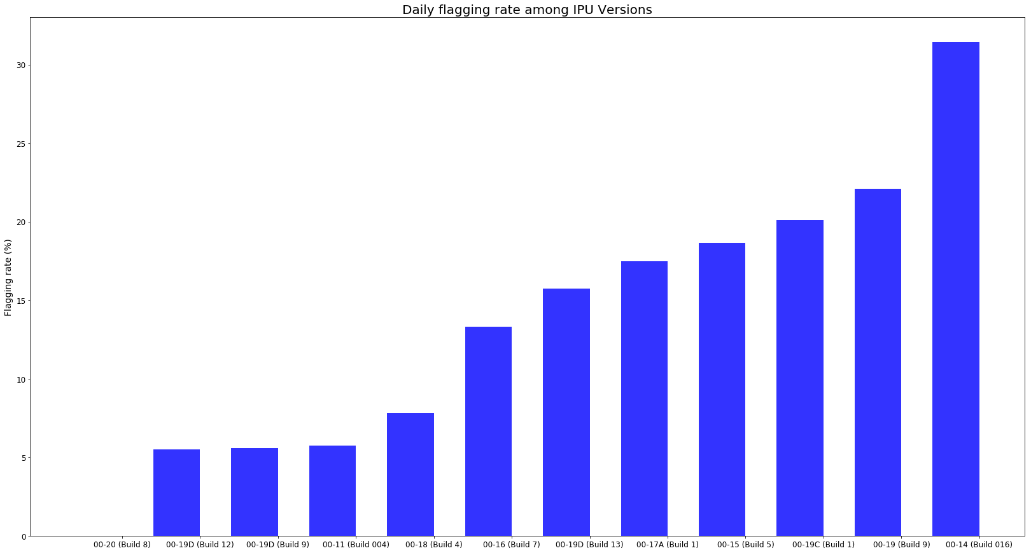
Exploratory analysis

Slide 8
Prediction model
Prediction based on Recurrent Neural Network on time series data
Anomaly detected

